Slide 2
Introduction
Facebook is a social networking service provider.
It lets you invite and connect with friends, send messages and pictures, like and comment or share them.
Facebook has seen outstanding growth since its inception and is poised to maintain its dominance in social networking.

Slide 3
History of Facebook
Facebook was founded by Harvard student Mark Zuckerberg on February 4, 2004.
In May 2007, Facebook opened up its developer platform to allow third-party developers to build applications and widgets that, once approved, could be distributed through the Facebook community.
In May 2008, Facebook engineers announced Facebook connect, a cross-site initiative that allows users to publish on third-party sites in their Facebook newsfeed.
The site was redesigned in late 2008, intended to streamline the website and make it easier to see what friends were doing.

Slide 4
What is Facebook Marketing?
Facebook is undoubtedly the most popular social
media platform available with many advantages
associated with it.
It is primarily a social networking site, however it can
be used as a handy tool for promoting and advertising a business. We can use Facebook to promote a brand, market a company, or create awareness about a service or a product.
Success with this form of marketing requires more than a fan page and a few friends. When used effectively, Facebook marketing can provide a business with exciting benefits and results.
Facebook marketing can enable businessmen to greatly improve their brand awareness and reach out to a wider audience.

Slide 5
How to Create a Fan Page?
A Facebook fan page is an amazing way to promote your business, build awareness for a cause, and gather support for your brand.
If you would like to create a fan page, follow these easy steps −
Log in to your Facebook account.
Click on the settings on the top right-hand corner of your page.
Click on create page.
Click on the type of page you would like to create.
Fill in all the information required.
Click on "get started".
Upload a profile picture and click on save photo.
Complete the 'about' section and click 'save info'.
Now decide whether you want to enable ads or skip (it will be payable if you enable).

Slide 6
Facebook Profiles
Facebook Profiles are for people and they are generally meant for personal use only.
A Facebook profile is an account that is allocated against an individual, who can use it to network with friends and colleagues, and share information with them.
It is designed to be a unique profile on the Facebook network for that one individual, and it is not meant to be used to represent a company, an organization, or a fictional character.

Slide 7
Facebook Places
Facebook Places enable people to provide real-time update of where they are and what they are doing when they are on the move.
It also enables its users to take advantage of unexpected coincidences such as discovering that they are at some concert as their friends. Users can check in when they arrive at a location, and see whether their friends are nearby.
The best part about Facebook places is that it will more or less maintain itself once it has been created.
Facebook users do have the ability to 'like' the Facebook places as well, so encourage visitors to press the 'like' button after they check in.

Slide 8
Facebook Groups
Facebook Groups are the places for small group communication where users can share their common interests and express their opinion.
Groups allow people to come together around a common cause. Groups are for discussing issues and share related content.
When we create a group, we can decide whether to make it publicly available for anyone to join, require administrator approval for members to join, or keep it private and by invitation only.
Groups range widely − from light-hearted themes to organizing activities to serious topics such as politics and world events.

Slide 9
Facebook Community
A Facebook Community is about an organization, a celebrity, or a topic.
Community pages are meant for general topics and all kinds of unofficial but interesting things.
These pages let us stay connected with others who share similar interests and experiences.

Slide 10
Grow Your Business with Facebook
Facebook is fast becoming a powerhouse of marketing activity due to the sheer number of engaging users on the site and the simplicity of connecting with them directly.
Facebook can provide your business with a branding outpost on the web where customers, employees, and even the media can find information about your company, products, and services. Facebook connects you and your staff directly to your customers and fans.
Facebook can generate new leads for your business by drawing users’ attention towards what you are offering. Facebook helps in sharing links, images, and posts on a customizable page to project a better sense of your business.

Slide 11
Latest Facebook Trends
The nature of social media marketing is ever-changing, so it is important to constantly stay updated with what the current market trends are.
The latest Facebook trends that a business should be aware of are − using the cover photo for marketing, different types of Facebook posts, more pictures, etc.
Facebook looks completely different from how it was a year ago, so it should not be surprising that marketing on the social network has also changed a great deal.

Slide 12
What are Adverts?
Adverts on Facebook are unique.
They are shown to specific groups of highly engaged people.
If your adverts have a great creative content and are well targeted, they get more likes, comments, and shares.
When we boost our page posts or expand the audience for the adverts, more people will see them when they visit Facebook.
Facebook ads allow us to promote our business, get more fans to our business page, and drive more leads for our sales team.
Facebook ads allow us to advertise a website or content that we manage on Facebook (like a group, page, or event)

Slide 13
Facebook − Do's and Don'ts
Do's
Use Facebook to stay in touch with your friends and make new ones.
Use Facebook to advertise your organization’s events.
Use Facebook to get involved with the campus community and learn what is happening around.
Use Facebook customer support page since it contains valuable information about privacy controls and other important safety information.
Do check each friend request carefully after visiting their profile.
Do use "privacy settings" while building up your photo albums.

Slide 14
Facebook − Do's and Don'ts
Don'ts
Don't use your wall to announce your schedules, journey and planning.
Don't use public walls as your own.
Don't accept friend requests from strangers.
Don't use Facebook for ragging and bullying anyone.
Don't post pictures of your friends without their permission.
Don't disclose personal information such as cell phone number, address, etc., unless you feel comfortable.

Slide 15
Increase Facebook Likes for a Fan Page
Create a Facebook fan page with an instantly appealing image.
Keep the Facebook fan page up to date by writing suitable description and posting interesting and friendly page titles. Always try to provide your readers with something fresh to read.
If you are running a contest on your page, then ask your visitors to like your fan page. Facebook contests are the easiest way to get people excited, as the lure of a big prize compels your target customers to 'like' your page and become your fan.
If you are running a business, then you should promote your fan page by using ads in the Facebook, as it is the easiest way to increase the visibility of your brand.
Promote your page on your official website because it helps you to get likes from new visitors on your site.
Synchronize your Facebook page with your other profiles on other social networking sites like Twitter, dig, etc.
Sometimes educational content is a better incentive for a 'like' than a discount offer or a prize, depending on your industry or the target audience.

Slide 16
King of the Social Networks
Over 1.3 billion active users around the world
Smartphone users check their accounts
Mark Zuckerberg donated $1 billion to charity in 2013, making him the biggest charitable donor in the U.S.
48% of young Americans said they found out about news through Facebook
15 times a day

Slide 17
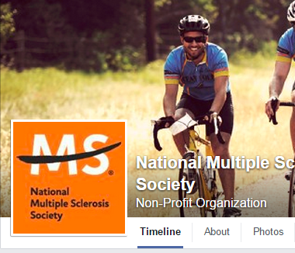
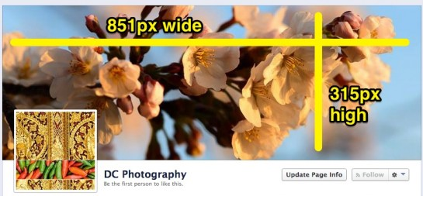
Tips to Sizing a Profile Picture & Cover Photo
Profile Picture
Choose an image that will work well as a small size
must be at least 180x180 pixels when uploading, displayed as 160x160 pixels
Cover Photo
must be at least 399px wide and 150px high when uploading, displayed as 850 wide x 315 tall
If you upload a larger image you’ll be given a chance to move & reposition it by dragging to choose the crop you’d like displayed
*Save image as a JPG or PNG*
*Don’t forget it’s always PUBLIC*
Notes:
Tip: If your profile picture is blurry after it’s downsized, try uploading an image twice the size of the downsized image (that is, an image that is 336px by 336px). Often gives a sharper result.

Slide 18
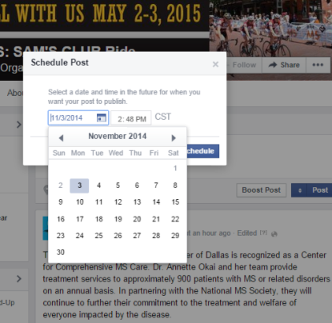
Facebook Posts - How To
Tagging someone in a post or Page
Use @ symbol, then type name → suggestions might auto-populate
When commenting on a post, you can link to someone in your response by following the same steps
# Hashtags
Turns topics and phrases into clickable links in your posts
Use search bar to find posts about topics you’re interested in
Must be written as a single word, without any spaces
You can include numbers in a hashtag, but punctuation and special characters (like $ and %) won't work
#bikems #impactMS
Scheduling a post
Choose the month, day, and time
Can view/edit post once it is scheduled

Slide 19
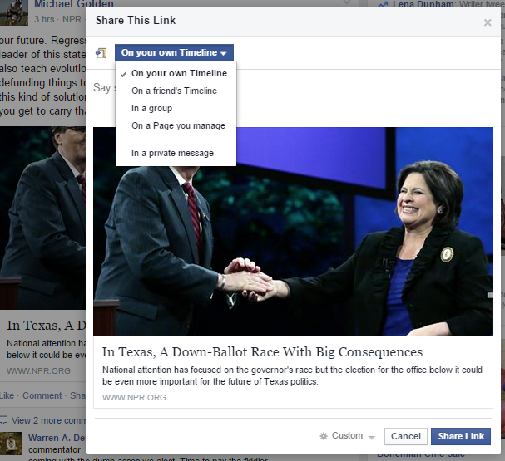
Facebook Posts - How To
Keep your content short
Add your location with a post
Upload an image
Share a post
On your Timeline
Friends Timeline
In a group
Private message
On a page you manage
Privacy settings on post

Slide 20
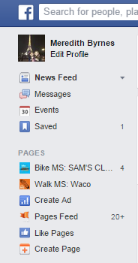
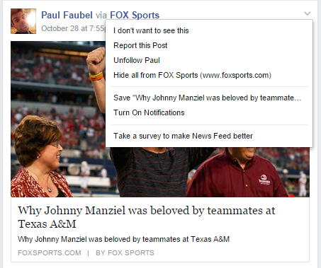
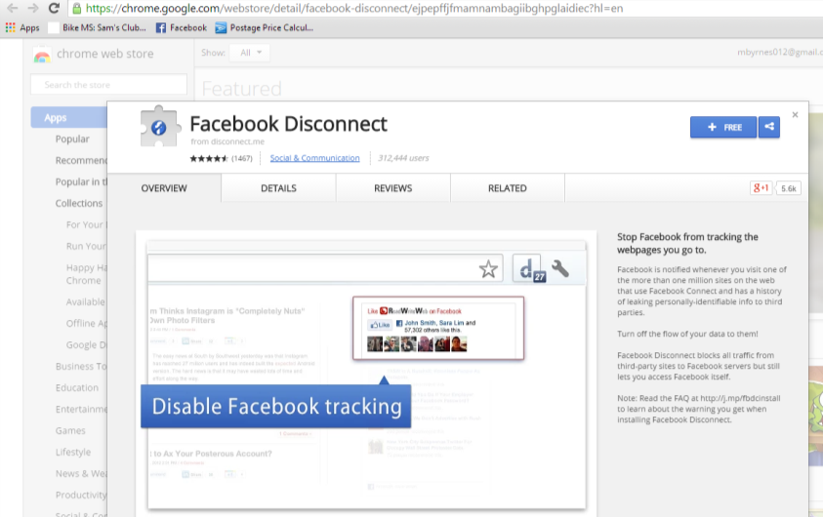
Tips to Using Facebook
Save links, places, & entertainment pages on your News Feed
Unfollow status updates from “oversharers”
Stop Facebook from tracking you
..
Facebook Disconnect is available for Firefox and Chrome

Slide 21
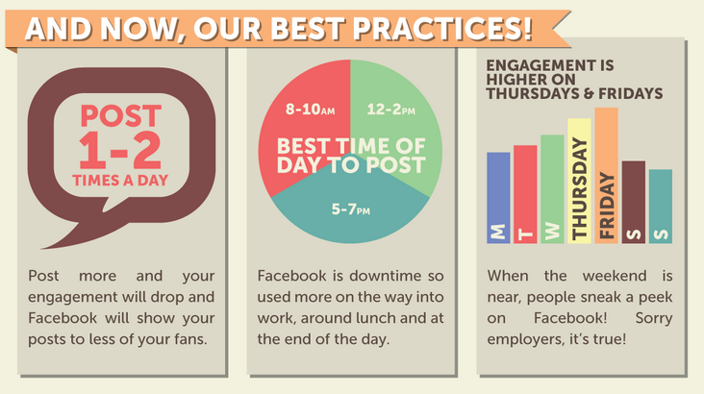
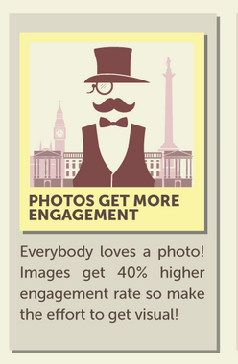
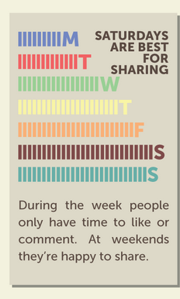
Getting the MOST Engagement with your Posts

Slide 22
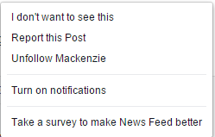
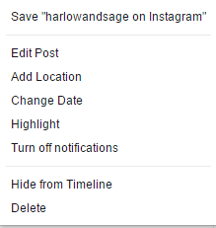
Example Post
Posts from Friends
Your Posts

